Slide 1
EMERGENCY ASSISTANCE SYSTEM FOR VEHICLES

Slide 2
Content
Introduction to EASV
Aim and Objective
Features
Hardware and software requirements
Proposed system
Working
Implemented model
Limitations
Reference

Slide 3
Introduction
EASV is a system developed for providing emergency assistance to drivers who are met with accidents.
It provides many other features at lower price than many other car product available in the market that makes this system a cost efficient car utility product.

Slide 4
Aim and Objective
Aim of our project is :
to provide assistance as quick as possible to people who met with an accident and to provide additional features in same system to make it a good car product.

Slide 5
Aim and Objective
The main objective of the project is :
to provide alert messages about distance of nearby vehicles
to get help to people who met with an accident by sending their location to their family members
to enhance car features using additional functions such as media player.

Slide 6
FEATURES
Accident detection
Flip or fall detection
Vehicle tracker
SMS to relatives with GPS coordinates
Obstacle detection
Access to Raspbian OS using LCD touchscreen
GPS navigation

Slide 7
Hardware and software specifications
Hardware:
Raspberry PI Model B
Micro SD card
Ultrasonic sensor HC-SR04
ADXL345 - Triple-Axis Accelerometer
Adafruit Ultimate GPS Breakout
Huawei e173 dongle
Prepaid SIM card

Slide 8
Hardware and software specifications
Software :
Raspbian OS
Python
OMX player

Slide 9
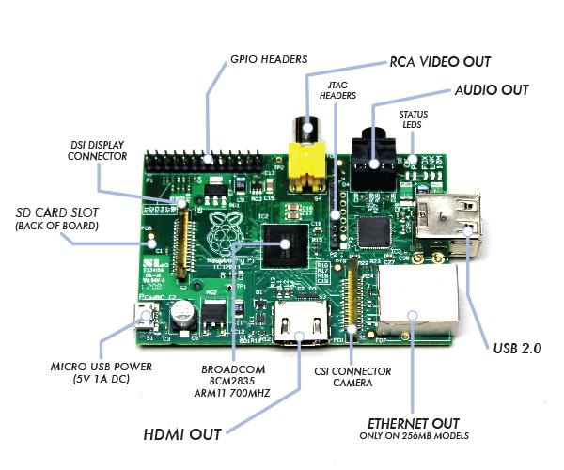
Raspberry pi
Raspberry PI model

Slide 10
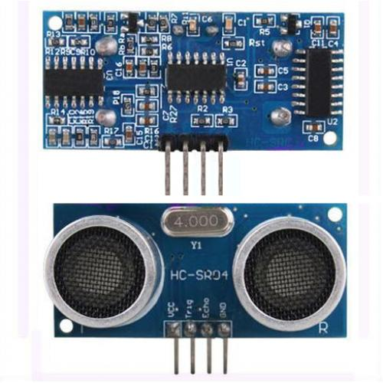
Ultrasonic sensor HC-SR04

Slide 11
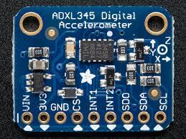
ADXL345 - Triple-Axis Accelerometer

Slide 12
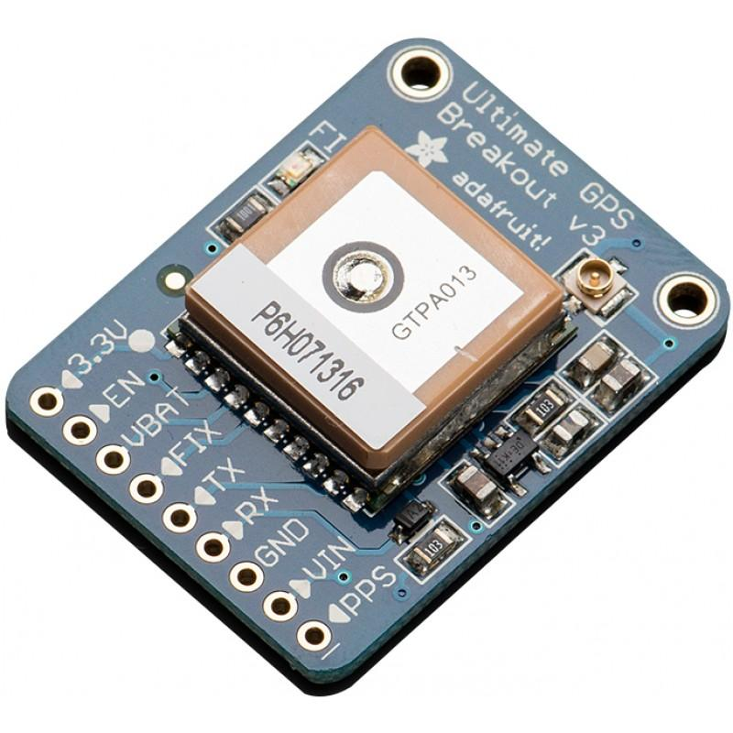
Adafruit Ultimate GPS Breakout

Slide 13
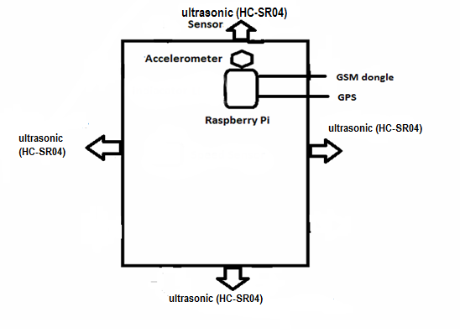
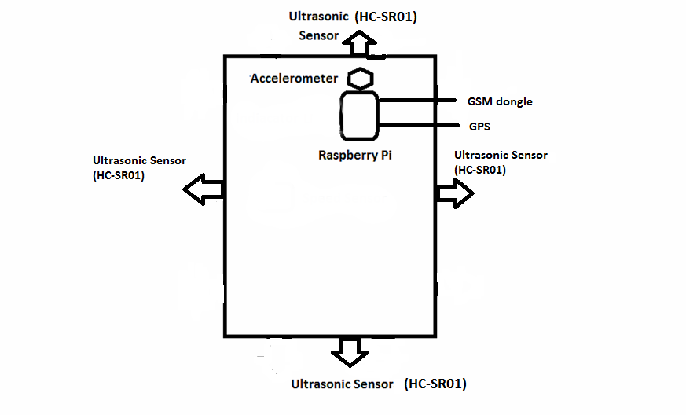
Proposed System

Slide 14
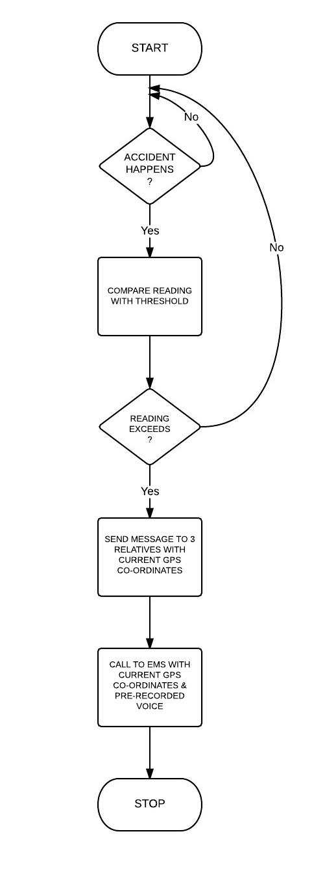
Working

Slide 15
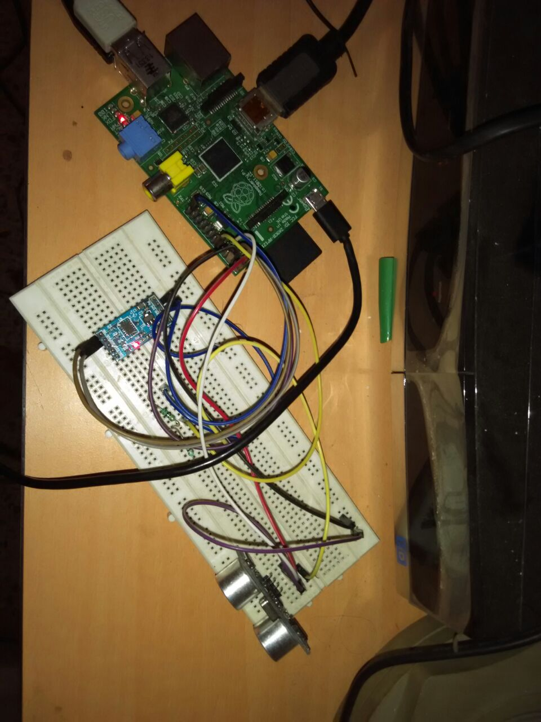
Implemented Model

Slide 16
Limitations
System won’t be able to send sms or call where network is not available.
System won’t be able to track the vehicle if the system is switched off.
In rare accident cases there can be a possibility of false alarm.

Slide 17
REFERENCES
http://www.mattiasnorell.com/blog/send-sms-from-a-raspberry-pi/
http://www.bytecreation.com/blog/2013/10/13/raspberry-pi-ultrasonic-sensor-hc-sr04
http://ijcsmc.com/docs/papers/March2014/V3I3201499a12.pdf
http://www.slideshare.net/bunny2arya/intelligent-autonomous-system-for-cars?related=2
http://www.danmandle.com/blog/getting-gpsd-to-work-with-python/
http://www.raspberrypi.org/forums/viewtopic.php?t=58055&p=436622
http://www.raspberrypi.org/forums/
http://www.adafruit.com/blog/2014/07/04/adxl345-accelerometer-python-for-raspberry-pi/
http://www.instructables.com/id/Accelerometer-Gyro-Tutorial/?ALLSTEPS
http://ozzmaker.com/2013/04/29/guide-to-interfacing-a-gyro-and-accelerometer-with-a-raspberry-pi/
http://www.instructables.com/id/Accelerometer-Gyro-Tutorial/?ALLSTEPS
http://www.stuffaboutcode.com/2014/06/raspberry-pi-adxl345-accelerometer.html
http://en.wikipedia.org/wiki/Inertial_measurement_unit
http://learn.adafruit.com/downloads/pdf/adafruit-ultimate-gps-on-the-raspberry-pi.pdf
http://randomnerdtutorials.com/complete-guide-for-ultrasonic-sensor-hc-sr04/
http://hackaday.com/2013/09/30/using-a-raspberry-pi-to-give-your-car-more-features/

